Slide 1

Feedback - Week 3
Reflection Journal
Going well
  Good examples
  Good formatting by more students
  Use of visualizations
  Specifics:
    Click-through rate (previous student)
    How to explain the “magic” – Someone who has read millions of emails and picked some of the “signs”.
    Dynamic pricing subject – a customer vs. a vendor perspective; limits of optimization.

Slide 2
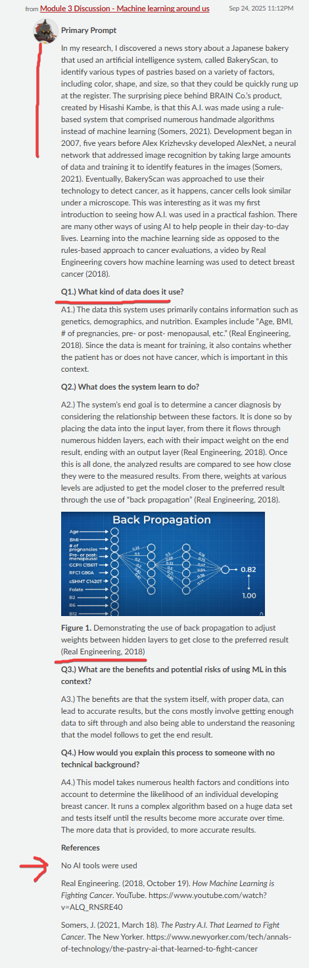
Feedback - Week 3
Reflection Journal
Going well:
  Good formatting, visualization used (previous student):

Slide 3

Feedback - Week 3
Reflection Journal
To improve
  Late or missing posts
  “It runs a complex algorithm based on a huge data set”. – Which? How?
  “A specific design or architecture is chosen for the model.” – Which? How?
  How about:
  “find people with similar tastes and see what else they watch.” (recommendation system)
  “someone who has read millions of emails, and developed a sense of” (spam filter)
  a child learning a language from the "street" rather than from the grammar books (ML)

Slide 4
Feedback - Week 3
Assignment
Going well:
  High grades, well done by many
  Formatting is improving
  Previous student noted: “Google's Teachable Machine is a zero-code tool. “
  Found failures and weaknesses of the model (many students)
  Mitzie trained the audio classifier

Slide 5
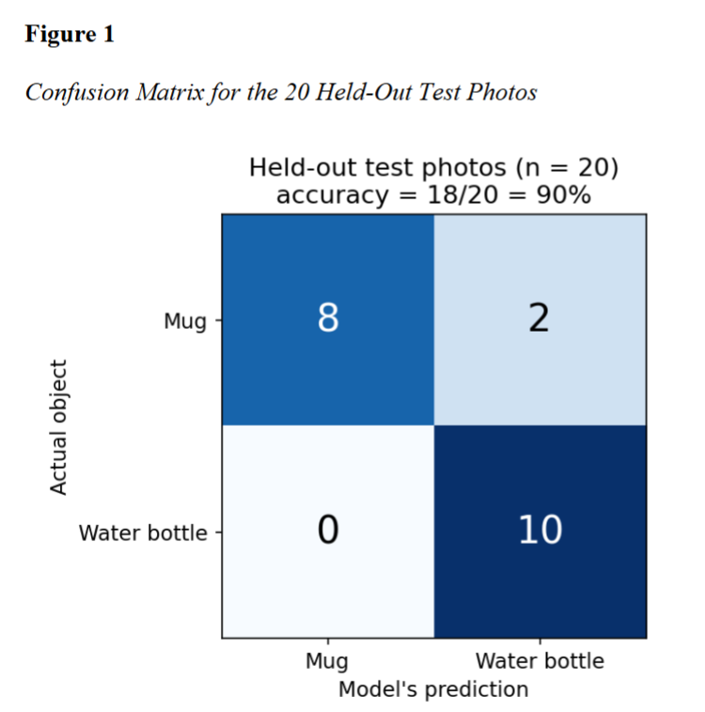
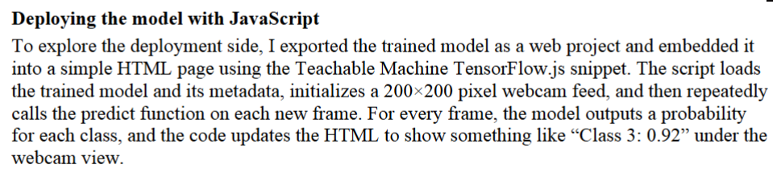
Feedback - Week 3
Assignment
Going well:
  Quantification - confusion matrix, formatting (Michael):
  Deployment (previous students):

Slide 6
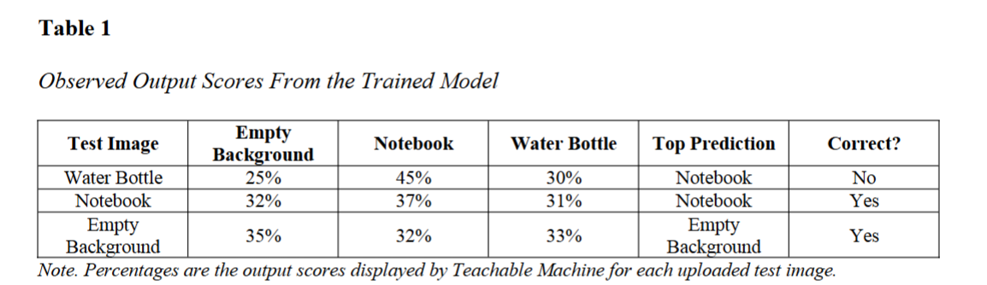
Feedback - Week 3
Assignment
Going well:
  Useful quantification (Qianhao)

Slide 7
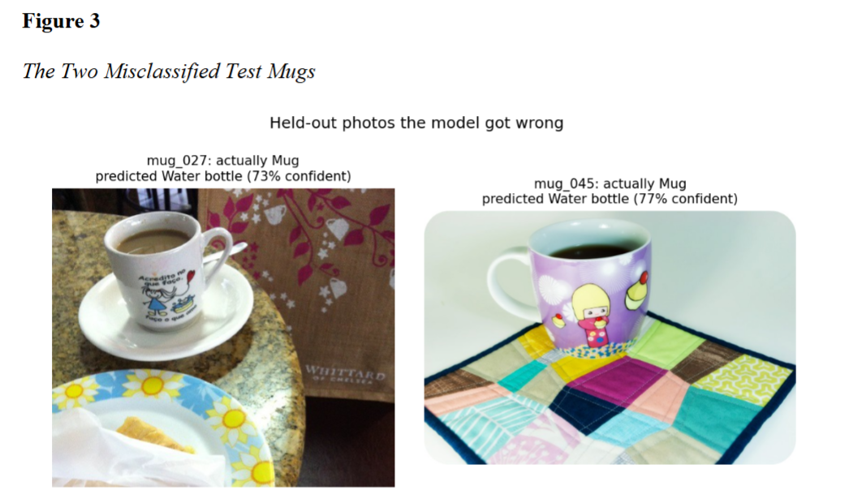
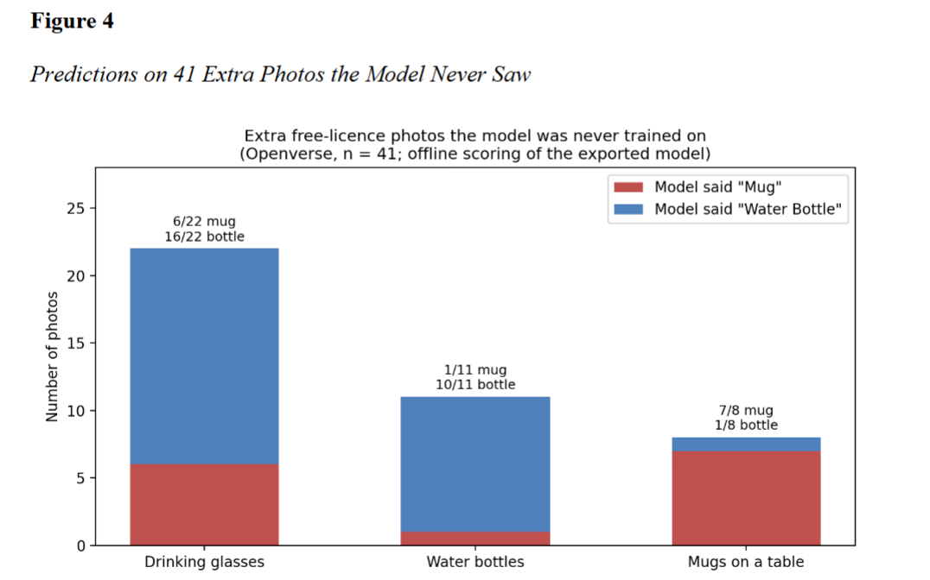
Feedback - Week 3
Assignment
Going well:
  Good analysis, misclassified(Michael):

Slide 8
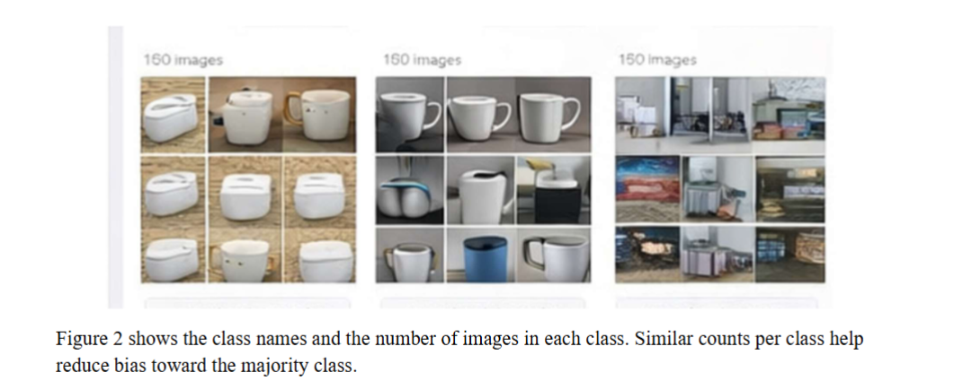
Feedback - Week 3
Assignment
Going well:
  Good visuals – experiment setup (previous student):

Slide 9
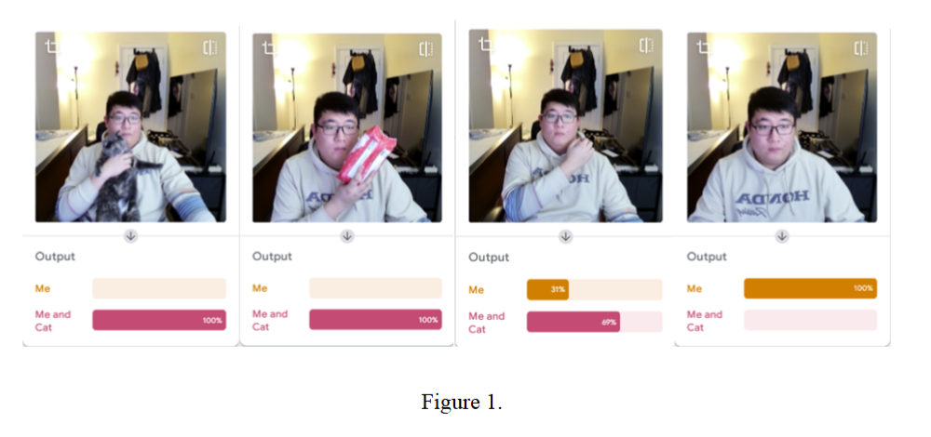
Feedback - Week 3
Assignment
Going well:
  Good visuals and non-trivial task (“Me” vs “Me and cat”) (previous student):

Slide 10
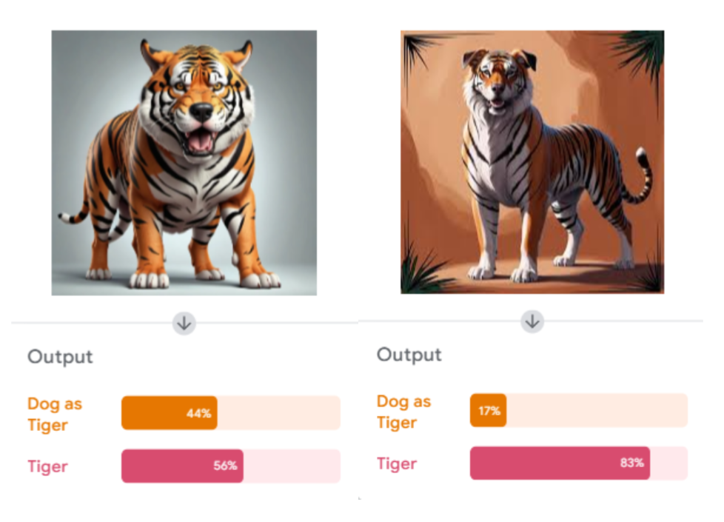
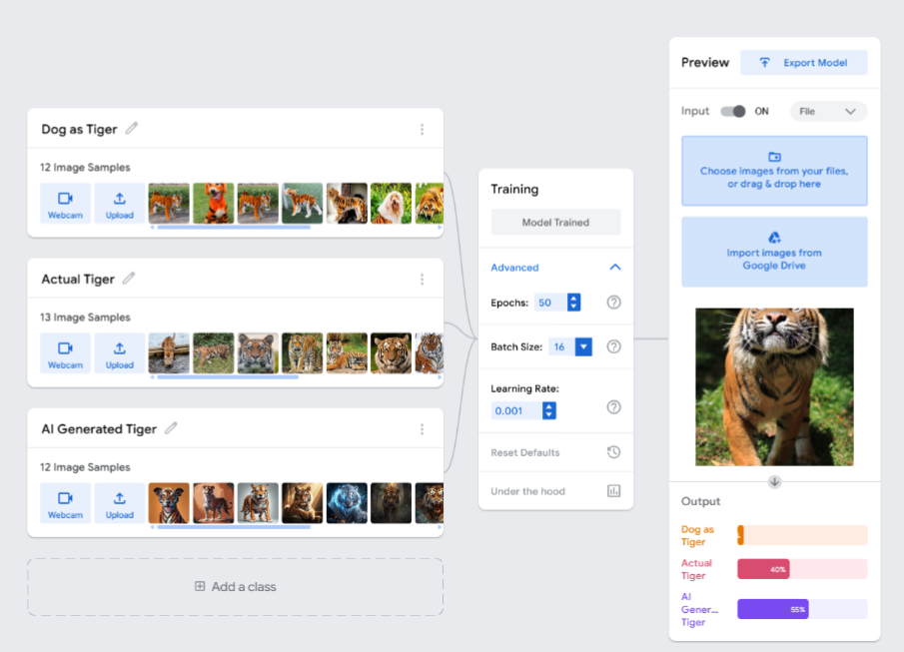
Feedback - Week 3
Assignment
Going well:
  Previous student made the tool “sweat”☺

Slide 11
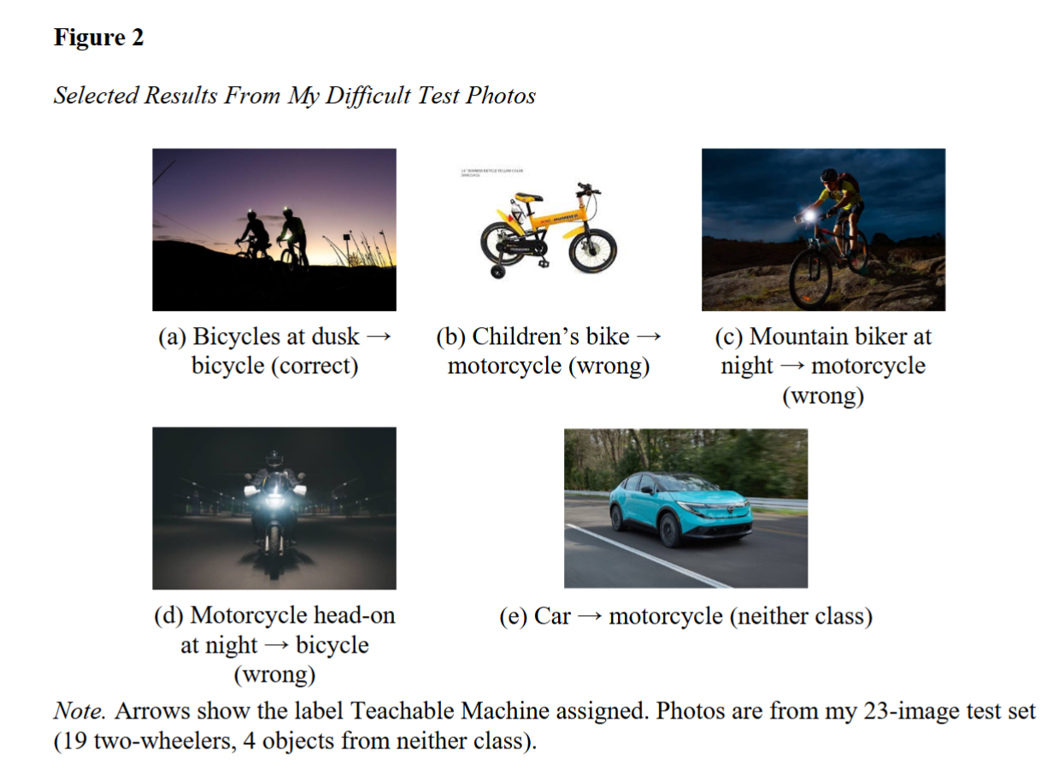
Feedback - Week 3
Assignment
Going well:
  Nathaniel challenged the tool:

Slide 12
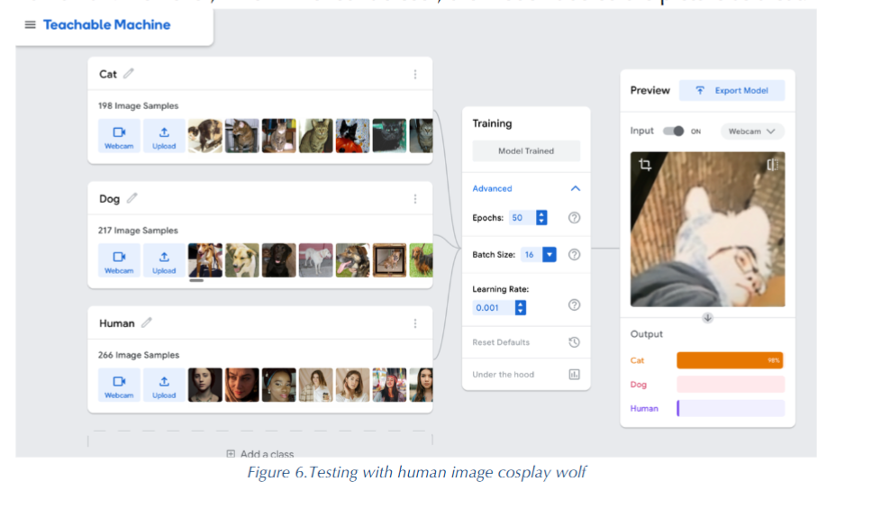
Feedback - Week 3
Assignment
Going well:
  Previous student challenged the tool:

Slide 13
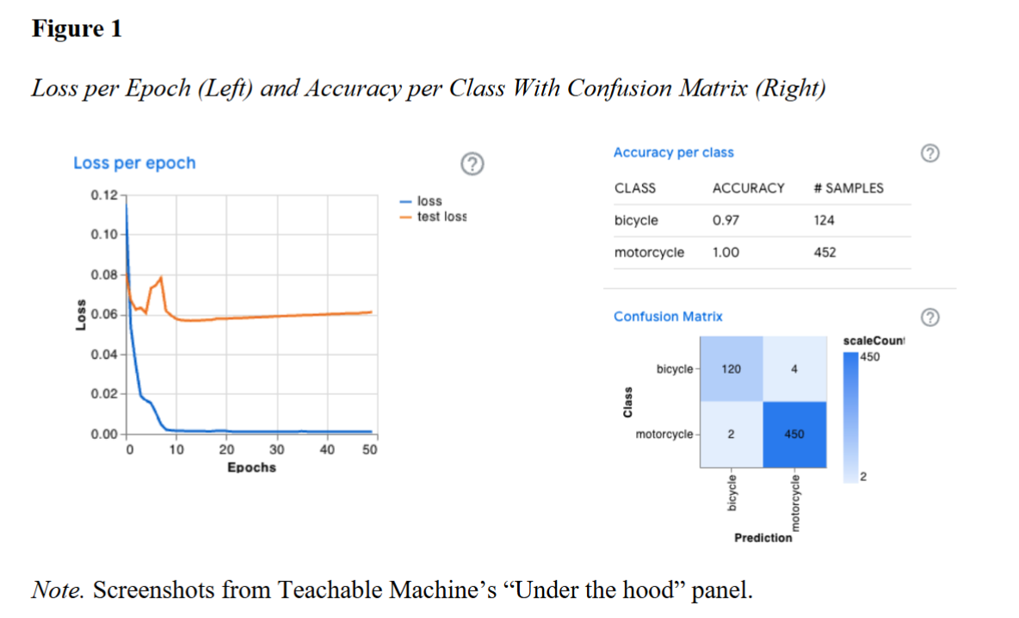
Feedback - Week 3
Assignment
Going well:
  Nathaniel, Dan:
  “I personally also split my dataset into 75% training and 25% testing through random sampling without replacement.” ->
  "I downloaded two classes of images from images.cv (n.d.): 3,012 photos of motorcycles and 823 of bicycles."
Previous student
  “The model correctly identified 18/25 children as children (recall of 0.72). It predicted a total of 20 children, with 2 incorrect predictions (precision of 0.9). Overall accuracy was 82%.”

Slide 14
Feedback - Week 3
Assignment
To improve – formal matters
  Missing/late submissions!
  A report without a single visual doesn’t make sense. From the assignment definition, “Include visuals whenever appropriate.“
  Why do classes have different numbers of instances? What are the consequences?
  Provide a quantitative description of your experiment.
    How many instances of Class A,B, etc., did you have?
    What was the accuracy of your experiment? We discussed the evaluation metrics (“Measuring success”) in class.
  Testing on a handful of images is better than no testing, but is it sufficient?

Slide 15
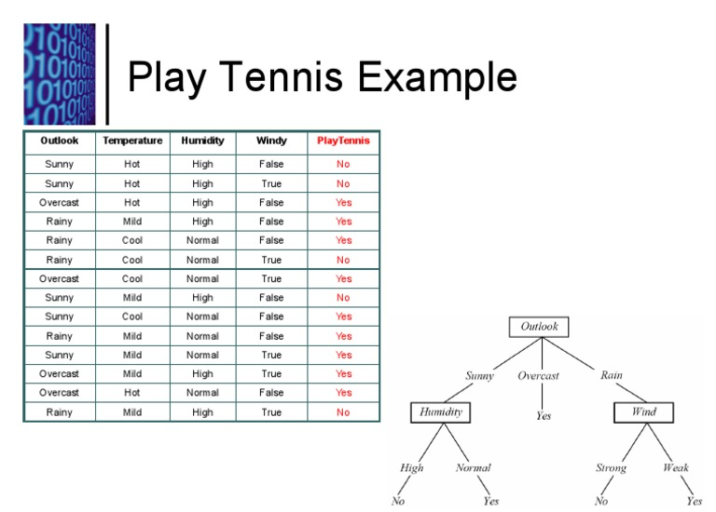
Follow-Up (Weeks 2,3)
More about Decision Trees
Decision Trees: rule-based or data-driven structure of if-then-else?
  “Rules are formed with the things we know; machine learning reveals things we don’t know.”
Decision trees and rule-based systems may look similar when visualized, but:
  Rule-based system – handcrafted
  Machine learning – learned from data
Notes:
https://www.youtube.com/watch?v=DOy-g3bsxT8

Slide 16

Miscellanious
From the news … (VIDEO 2:00)
https://www.youtube.com/watch?v=c7vetvwsn-Q.

Slide 17
Miscellanious
Updated Bonus Lecture “Advanced Subject In AI” is Released

Slide 18
Topics Covered
Course Tracker
Week # | Topic
1 | Overview of AI, history, definitions, and key concepts
2 | Knowledge Representation and Reasoning
3 | Introduction to Machine Learning
4 | Neural Networks & Deep Learning
5 | Distributed AI & AI Platforms
6 | Natural Language Processing (NLP)
7 | Computer Vision
8 | Robotics & Embodied AI
9 | AI & Creativity
10 | Applications of AI – Healthcare, Finance, Education, Retail, Marketing, Entertainment
11 | Applications of AI – Biomedical, Agriculture, Transportation, Mining, Manufacturing, Energy
12 | AI and Society, Bias & Fairness in AI
13 | The Future of AI
14 | No Lecture - Final Project Report & Presentation

